Slide 1


Data Mining on Diabetes Detection
Presented by
Rupak Upadhyay (202222020)
Aditya Pradhan (202222017)
Asha Kumari (202222018)
Under the Guidance of
Mr. Gaurav Pradhan, Asst. Professor, Dept. of CA, SMIT
Dept. of Computer Application, SMIT, Majhitar, East Sikkim

Slide 2
Content
Introduction
General Overview of the problem
Aim and Objective
Feasibility Study
Literature Study
Problem Definition
Proposed Solution Strategy
Project Plan
Workflow Chart
Method and Methodology
Result and Discussion
Summary and Conclusion
References

Slide 3
Introduction
Diabetes is a long-term health problem that happens when the body has trouble handling the sugar in our blood, which we call glucose.
There are mainly two types of diabetes: Type 1 and Type 2. There’s also gestational diabetes that can occur during pregnancy
Type 1 diabetes is known for a deficit in insulin production and requires daily administration of insulin.
Type 2 diabetes is a condition that happens because of a problem in the way the body regulates and uses sugar as a fuel.

Slide 4
General Overview of the Problem
In the current times, many medical diagnoses are performed by machine learning, as they are accurate, and fast.
Most of the algorithms present are highly optimized and complex for a regular person with no coding knowledge to understand.
This research aims to search for an efficient way of detecting diabetes i.e., getting good accuracy while keeping the complexity of the used algorithms as low as possible

Slide 5
Aim and Objective
The majority of the machine learning models currently available are complex.
So to get a high success rate in detecting diabetes the developers of these models optimize the algorithms as much as possible.
The challenge of this research lies in the fact that to get higher accuracy a more complex model is required.
The aim and objective of this study is to make the model as simple as possible.

Slide 6
Feasibility Study
Economic Feasibility
The tools used in this study will be open-source.
So, there will be no need for any external funding.
Technical Feasibility
This study will use a modern laptop with a reasonable processing capability.
This study will use Python libraries (sci-kit-learn, pandas, numpy) and IDE (Visual Studio Code).
Operational Feasibility
The team conducting this study consists of MCA students and is equipped with the knowledge and skills required to complete this study.
Schedule Feasibility
Will be completed within the stipulated time.

Slide 7
Literature Survey
Table. Literature Survey
Serial No. | Name of article | Detection Type | Findings | Research Gap | Relevant to Proposed work
1. | Luís Chaves et. al. [2021] “Data Mining Techniques for Early Diagnosis of Diabetes: A Comparative Study”[2] 2021 MDPI | Supervised | Methodology: Classification: Naïve Bayes, Neural Networks, AdaBoost, kNN, Random Forest, Support Vector Machine Dataset Used: The data was collected using direct questionnaires from the patients of Sylhet Diabetes Hospital in Sylhet, Bangladesh Results: Neural Network achieved 98.1% accuracy | The data set has limitations since it does not consider family history of diabetes, consumption of certain prescription drugs, smoking, and sleep deprivation. | Classification: Random Forest, Naïve Bayes, kNN, SVM

Slide 8
Literature Survey
Contd..
Table. Literature Survey (contd..)
Serial No. | Name of article | Detection Type | Findings | Research Gap | Relevant to Proposed work
2. | S. Saru et. al. [2019] “Analysis and Prediction of Diabetes Using Machine Learning”[1] 2016 SSRN | Supervised | Methodology: Feature Selection: Principal Component Analysis Classification: Random Forest, k-Nearest Neighbors, Decision Tree, Support Vector Machine, Logistic Regression Dataset Used: PIMA Indian Diabetes Data Results: Decision Tree achieved 87% accuracy | Small amount of sample data was used. Only a single data set used, in future multiple data set can be used for detection. | Feature Selection: Principal Component Analysis Classification: Random Forest, Support Vector Machine, k-Nearest Neighbors

Slide 9
Literature Survey
Contd..
Table. Literature Survey (contd..)
Serial No. | Name of article | Detection Type | Findings | Research Gap | Relevant to Proposed work
3. | F. A. Khan et. al. [2021] “Detection and Prediction of Diabetes Using Data Mining: A Comprehensive Review”[3] 2021 IEEE | Supervised | Methodology: Classification: Artificial Neural Networks, Support Vector Regression, Decision Tree, Support Vector Machine, Navie Bayes, Random Forest, Instance Based Learner Classifier, Quadratic Discriminant Analysis Dataset Used: Dataset collected from an online portal and a college medical hospital Results: ANN achieved 89% accuracy | It is evident from the analysis of the schemes in all classes that most of them suffer from either single data input parameter or the parameter selection process is not optimal. | Classification: Artificial Neural Networks, SVM, Random Forest, Naïve Bayes

Slide 10
Literature Survey
Contd..
Table. Literature Survey (contd..)
Serial No. | Name of article | Detection Type | Findings | Research Gap | Relevant to Proposed work
4. | Wee et. al. [2023] “Diabetes Detection Based on Machine Learning and Deep Learning Approaches”[7] 2023 Springer | Supervised | Methodology: Feature Selection: Pearson Correlation Coefficient, Fuzzy Support Vector Machine, F-Score Feature Selection Classification: Support Vector Machine, Random Forest Dataset Used: Pima Indians Diabetes Data Results: Random Forest achieved 79.26% accuracy | Standard procedure is not proposed for collecting the required data for further investigation and improving the classification models. Features such as ECG are not proven to have a direct relationship to diabetes | Feature Selection: F-Score Feature Selection Classification: Random Forest, SVM

Slide 11
Problem Definition
The majority of the machine learning models currently available are complex.
So to get high success rate in detecting diabetes the developers of these models optimize the algorithms as much as possible.
The challenge of this research lies in the fact that to get higher accuracy a more complex model is required.

Slide 12
Proposed Solution Strategy
To get high accuracy while keeping the complexity of the machine learning model low, the team will use five feature selection algorithms, to select features from a dataset.
Then use six classification algorithms to detect diabetes, from these newly acquired datasets of selected features. The plan is to keep the parameters of these algorithms as simple as possible.
The steps:
Data Acquisition and Preprocessing
Feature Selection
Classification
Evaluation

Slide 13
Project Plan
Mr. Gaurav Pradhan
(Project Guide)
Aditya Pradhan
(202222017)
Asha Kumari
(202222018)
Rupak Upadhyay
(202222020)
Fig. Team Structure

Slide 14
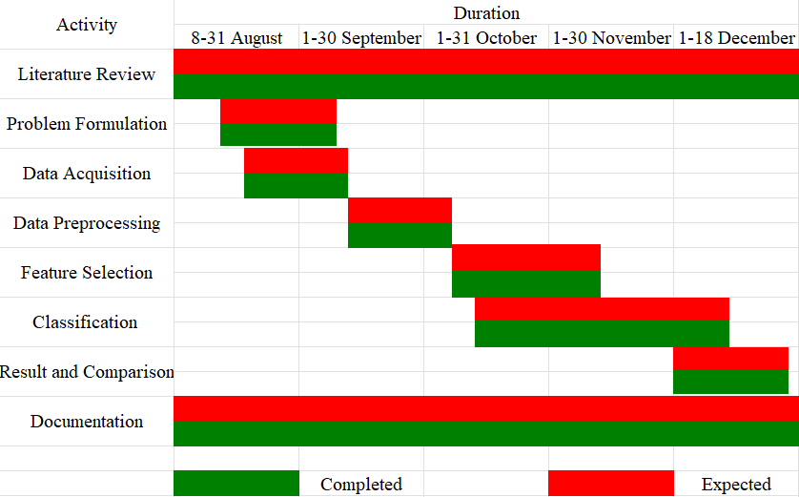
Project Plan
Contd..
Fig. Gantt Chart

Slide 15
Project Plan
Contd..
Hardware Requirement | Software Requirement
Processor: Intel Core i3 7th Gen+ or AMD Ryzen 3 2nd Gen+ Memory: 4GB DDR3 RAM Storage: 50GB | Operating System: Microsoft Windows 7 and above Programming Language: Python Development Environment: Visual Studio Code, Weka

Slide 16
Workflow Chart
Start
Data Acquisition
Data Preprocessing
F-Score
PCA
PCC
SVM RFE
Forward Stagewise Selection
Classification
DT
K-NN
NB
LR
SVM
RF
Result
Fig. Workflow Chart

Slide 17
Method and Methodology
Data Acquisition
Pima Indians Diabetes Database 768 individual records with eight features
Dataset2: 2535 individual records with 19 features
Data Preprocessing
Weighted k-NN
KNNImputer(n_neighbors = 10, weights = ‘distance’)

Slide 18
Method and Methodology
Contd..
Feature Selection
F-Score:
Selector = SelectKBest(score_func = f_classif, k = 5)
Principal Component Analysis:
PCA(n_components = 5)
X_pca = pca.fit_transform(X_scaled)

Slide 19
Method and Methodology
Contd..
Feature Selection
Pearson Correlation Coefficient:
correlation_matrix = df.corr()
corelation_with_target = correlation_matrix[‘tar_var’].abs()
sorted_features = correlation_with_target.sort_value(ascending = False)
sorted_features[1:6]

Slide 20
Method and Methodology
Contd..
Feature Selection
Support Vector Machine Recursive Feature Elimination:
svm = SVC(kernel = ‘linear’)
rfe = RFE(estimator = svm, n_features_to_select = 5)
rfe.fit(X_train, y_train)

Slide 21
Method and Methodology
Contd..
Classification
Decision Tree: weka.classifiers.trees.J48 -C 0.25 -M 2
K-Nearest Neighbor: weka.classifiers.lazy.IBk -K 1 -W 0 -A “weka.core.neighboursearch.LinearNNSearch -A \ “weka.core.EuclideanDistance -R first-last \””
Logistic Regression: weka.classifiers.functions.Logistic -R 1.0E-8 -M -1 -num-decimal-places 4

Slide 22
Method and Methodology
Contd..
Classification
Naïve Bayes: weka.classifiers.bayes.NaiveBayes
Random Forest: weka.classifiers.trees.RandomForest -P 100 -I 100 -num-slots 1 -K 0 -M 1.0 -V 0.001 -S 1
Support Vector Machine: weka.classifiers.functions.SMO -C 1.0 -L 0.001 -P 1.0E-12 -N 0 -V -1 -W 1 -K "weka.classifiers.functions.supportVector.PolyKernel -E 1.0 -C 250007" -calibrator "weka.classifiers.functions.Logistic -R 1.0E-8 -M -1 -num-decimal-places 4"

Slide 23
Result and Discussion
Table. Description ton of PIMA Indian Diabetes Database[19]
Serial No. | Features | Description
1 | Pregnancies | Number of pregnancies
2 | Glucose | Glucose tolerance test using plasma glucose concentration
3 | BloodPressure | Diastolic blood pressure(mm Hg)
4 | SkinThickness | Triceps skin fold thickness (mm)
5 | Insulin | 2-h serum insulin (mu U.ml)
6 | BMI | Body mass index
7 | DiabetesPedigreeFunction | Diabetes pedigree Function
8 | Age | Age in years
9 | Outcome | Class label(0 or 1)

Slide 24
Result and Discussion
Contd..
Table. Description ton of Dataset2
Serial No. | Features | Description
1 | Sex | The gender of the patient
2 | Age | Age of the patient in years
3 | History of high blood pressure | High blood pressure history of the patient (Yes or No)
4 | History of use of drugs for high blood pressure | Use of drugs for high blood pressure (Yes or No)
5 | Systolic blood pressure | Systolic blood pressure in mm of Hg
6 | Diastolic blood pressure | Diastolic blood pressure in mm Hg
7 | Height | Height of the patient in cm
8 | Weight | Weight of the patient in kg
9 | BMI | Body mass index
10 | history of diabetes | History of diabetes

Slide 25
Result and Discussion
Contd..
Table. Description ton of Dataset2
Serial No. | Features | Description
11 | Family history of diabetes | Diabetes in the patient's family
12 | History of aborted baby | Abortion performed on the patient
13 | History of gestational diabetes | Gestational diabetes in the patient (Yes or No)
14 | History of pregnancy | Pregnancy history of the patient (Yes or No)
15 | FBS | Fasting Blood Sugar test (mg/dL)
16 | Cholesterol | Cholesterol level measured in mg/dL
17 | HDL | High-density lipoprotein measured in mg/dL
18 | Triglyceride | Triglycerides level measured in mmol/L
19 | result of high blood pressure screening | Class label (Positive or Negative or Old patient)
20 | result of diabetes screening | Class label (Positive or Negative or Old patient)

Slide 26
Result and Discussion
Contd..
Table. Features selected using F-score
Pima Indians Dataset | Dataset2
Glucose SkinThickness Insulin BMI Age | Systolic blood pressure Diastolic blood pressure BMI Family history of diabetes History of aborted baby

Slide 27
Result and Discussion
Contd..
Table. Features selected using PCC
Pima Indians Dataset | Dataset2
Glucose SkinThickness Insulin BMI Pregnancies | Systolic blood pressure Diastolic blood pressure BMI Family history of diabetes result of high blood pressure screening

Slide 28
Result and Discussion
Contd..
Table. Features selected using SVM RFE
Pima Indians Dataset | Dataset2
Glucose DiabetesPedigreeFunction Age BMI Pregnancies | History of diabetes History of pregnancy result of high blood pressure screening Family history of diabetes History of aborted baby

Slide 29
Result and Discussion
Contd..
Table. Features selected using Forward Stagewise Selection
Pima Indians Dataset | Dataset2
Glucose Insulin Age BMI DiabetesPedigreeFunction | Age BMI HDL Family history of diabetes History of aborted baby

Slide 30
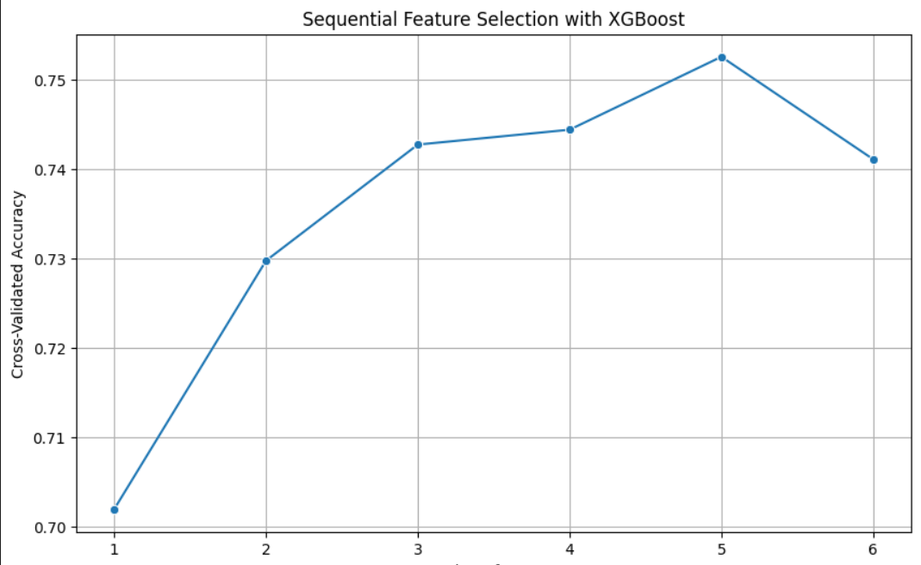
Result and Discussion
Contd..
Fig. Graph illustrating the performance of Forward Stagewise selection

Slide 31
Result and Discussion
Contd..
Table. Result of Classification algorithm on PIMA Indians Dataset
Feature Selection Classification | Forward Stagewise Selection | F-score | PCA | PCC | SVM_RFE
DT | 65.1042 | 65.1042 | 65.1042 | 65.1042 | 65.1042
kNN | 67.0573 | 64.4531 | 65.1042 | 65.8854 | 63.4115
LR | 57.1615 | 64.9740 | 65.1042 | 65.4948 | 59.7656
NB | 67.3177 | 69.5313 | 35.4167 | 69.2708 | 68.6198
RF | 64.7135 | 65.8854 | 65.1042 | 66.6667 | 66.4063
SVM | 65.2344 | 65.3646 | 65.1042 | 68.6198 | 64.8438

Slide 32
Result and Discussion
Contd..
Table. Result of Classification algorithm on Dataset2
Feature Selection Classification | Forward Stagewise Selection | F-score | PCA | PCC | SVM_RFE
DT | 91.4004 | 91.4004 | 91.4004 | 91.4004 | 91.4004
kNN | 91.4398 | 91.0848 | 91.3609 | 90.6114 | 91.4004
LR | 88.9152 | 88.7968 | 91.4004 | 87.9684 | 91.4004
NB | 91.5187 | 91.3215 | 8.6391 | 91.1637 | 91.4004
RF | 90.6509 | 91.4793 | 91.4004 | 91.5976 | 91.4004
SVM | 91.5582 | 91.5187 | 91.4004 | 91.4398 | 91.4004

Slide 33
Result and Discussion
Contd..
Table. Comparison of Accuracy
Algorithm Study | DT | kNN | LR | NB | RF | SVM
[25] | 81.3000 | - | 83.8600 | - | 87.4000 | 86.0200
[27] | - | 83.3300 | - | - | - | -
[1] | - | 97.3100 | - | 86.9200 | 96.9200 | 97.1200
[11] | 94.4400 | 93.7900 | - | 79.8400 | - | -
[9] | - | 78.4000 | - | 92.7000 | 96.9000 | 90.8000
This study | 91.4004 | 91.4398 | 91.4004 | 91.5187 | 91.4793 | 91.5582

Slide 34
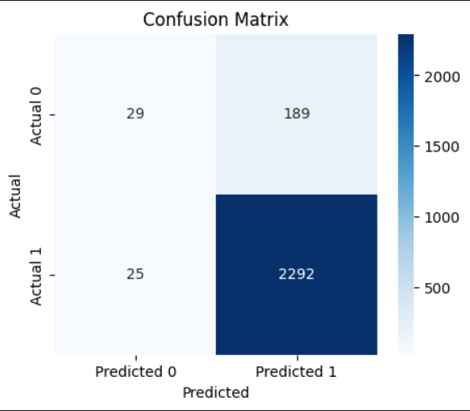
Result and Discussion
Contd..
Fig. Confusion Matrix visualizing the result of SVM classifier

Slide 35
Summary and Conclusion
Progress Summary
Outlined the challenges associated with existing learning models or detecting diabetes, wherein there is a trade-off between accuracy and complexity.
This study also proposes a well-structured solution strategy that aligns with the identified challenges.
While this study was in progress the study team reviewed many research papers to keep themselves up to date with the current trends and best practices in the field
This study is on schedule and will be completed by the established deadline.

Slide 36
Summary and Conclusion
Contd..
Conclusion
This study aimed to address the challenges of obtaining high accuracy in detecting diabetes while keeping the complexity of the machine learning model low
Two datasets were collected, namely Pima Indians Diabetes Database[19] and Datase2 which were pre-processed using a weighted kNN approach.
The features that were obtained showed that different algorithms selected different sets of features.
The highest accuracy achieved was 91.5582 using the SVM with features obtained from the forward stagewise selection.

Slide 37
Summary and Conclusion
Contd..
Future Scope
This study only considers a handful of feature selection and classification algorithms.
Further going on more classification algorithms can be used with their default parameters to see if they give more accurate results.

Slide 38
References
[1] L. Chaves and G. Marques, “Data mining techniques for early diagnosis of diabetes: A comparative study,” Appl. Sci., vol. 11, no. 5, pp. 1–12, Mar. 2021, doi: 10.3390/app11052218.
[2] B. F. Wee, S. Sivakumar, K. H. Lim, W. K. Wong, and F. H. Juwono, “Diabetes detection based on machine learning and deep learning approaches,” Multimed. Tools Appl., 2023, doi: 10.1007/s11042-023-16407-5.
[3] “Diabetes.” Accessed: Nov. 17, 2023. [Online]. Available: https://www.who.int/news-room/fact-sheets/detail/diabetes
[4] “Diabetes Facets and Figures | International Diabetes Federation.” Accessed: Nov. 17, 2023. [Online]. Available: https://idf.org/about-diabetes/diabetes-facts-figures/
[5] N. Jothi, N. A. Rashid, and W. Husain, “Data Mining in Healthcare - A Review,” Procedia Comput. Sci., vol. 72, pp. 306–313, 2015, doi: 10.1016/j.procs.2015.12.145.
[6] T. Hendrickx, B. Cule, P. Meysman, S. Naulaerts, K. Laukens, and B. Goethals, “Mining association rules in graphs based on frequent cohesive itemsets,” Lect. Notes Comput. Sci. (including Subser. Lect. Notes Artif. Intell. Lect. Notes Bioinformatics), vol. 9078, no. 3, pp. 637–648, 2015, doi: 10.1007/978-3-319-18032-8_50.
[7] S. Saru, “ANALYSIS AND PREDICTION OF DIABETES USING MACHINE LEARNING,” 2019. [Online]. Available: https://ssrn.com/abstract=3368308
[8] U. Ahmed et al., “Prediction of Diabetes Empowered With Fused Machine Learning,” IEEE Access, vol. 10, pp. 8529–8538, 2022, doi: 10.1109/ACCESS.2022.3142097.

Slide 39
References
Contd..
[9] D. D. Rufo, T. G. Debelee, A. Ibenthal, and W. G. Negera, “Diagnosis of diabetes mellitus using gradient boosting machine (Lightgbm),” Diagnostics, vol. 11, no. 9, Sep. 2021, doi: 10.3390/diagnostics11091714.
[10] R. Birjais, A. K. Mourya, R. Chauhan, and H. Kaur, “Prediction and diagnosis of future diabetes risk: a machine learning approach,” SN Appl. Sci., vol. 1, no. 9, Sep. 2019, doi: 10.1007/s42452-019-1117-9.
[11] F. Kazerouni, A. Bayani, F. Asadi, L. Saeidi, N. Parvizi, and Z. Mansoori, “Type2 diabetes mellitus prediction using data mining algorithms based on the long-noncoding RNAs expression: A comparison of four data mining approaches,” BMC Bioinformatics, vol. 21, no. 1, Aug. 2020, doi: 10.1186/s12859-020-03719-8.
[12] H. Lu, S. Uddin, F. Hajati, M. A. Moni, and M. Khushi, “A patient network-based machine learning model for disease prediction: The case of type 2 diabetes mellitus,” Appl. Intell., vol. 52, no. 3, pp. 2411–2422, Feb. 2022, doi: 10.1007/s10489-021-02533-w.
[13] N. Sneha and T. Gangil, “Analysis of diabetes mellitus for early prediction using optimal features selection,” J. Big Data, vol. 6, no. 1, Dec. 2019, doi: 10.1186/s40537-019-0175-6.
[14] R. B. Lukmanto, Suharjito, A. Nugroho, and H. Akbar, “Early detection of diabetes mellitus using feature selection and fuzzy support vector machine,” in Procedia Computer Science, Elsevier B.V., 2019, pp. 46–54. doi: 10.1016/j.procs.2019.08.140.
[15] L. Kopitar, P. Kocbek, L. Cilar, A. Sheikh, and G. Stiglic, “Early detection of type 2 diabetes mellitus using machine learning-based prediction models,” Sci. Rep., vol. 10, no. 1, Dec. 2020, doi: 10.1038/s41598-020-68771-z.
[16] V. Chang, J. Bailey, Q. A. Xu, and Z. Sun, “Pima Indians diabetes mellitus classification based on machine learning (ML) algorithms,” Neural Comput. Appl., vol. 35, no. 22, pp. 16157–16173, Aug. 2023, doi: 10.1007/s00521-022-07049-z.

Slide 40
References
Contd..
[17] R. Ahuja, S. C. Sharma, and M. Ali, “A diabetic disease prediction model based on classification algorithms,” Ann. Emerg. Technol. Comput., vol. 3, no. 3, pp. 44–52, Jul. 2019, doi: 10.33166/AETiC.2019.03.005.
[18] A. Iyer, J. S, and R. Sumbaly, “Diagnosis of Diabetes Using Classification Mining Techniques,” Int. J. Data Min. Knowl. Manag. Process, vol. 5, no. 1, pp. 01–14, Jan. 2015, doi: 10.5121/ijdkp.2015.5101.
[19] “Pima Indians Diabetes Database.” Accessed: Nov. 18, 2023. [Online]. Available: https://www.kaggle.com/datasets/uciml/pima-indians-diabetes-database
[20] “Feature Selection - F-score | Kaggle.” Accessed: Nov. 18, 2023. [Online]. Available: https://www.kaggle.com/code/tanmayunhale/feature-selection-f-score
[21] “Reduce Data Dimensionality using PCA - Python - GeeksforGeeks.” Accessed: Nov. 19, 2023. [Online]. Available: https://www.geeksforgeeks.org/reduce-data-dimentionality-using-pca-python/
[22] “Feature Selection - Pearson Correlation | Kaggle.” Accessed: Nov. 19, 2023. [Online]. Available: https://www.kaggle.com/code/tanmayunhale/feature-selection-pearson-correlation
[23] H. Sanz, C. Valim, E. Vegas, J. M. Oller, and F. Reverter, “SVM-RFE: Selection and visualization of the most relevant features through non-linear kernels,” BMC Bioinformatics, vol. 19, no. 1, pp. 1–18, 2018, doi: 10.1186/s12859-018-2451-4.
[24] “9.6 Feature Selection via Boosting.” Accessed: Nov. 19, 2023. [Online]. Available: https://jermwatt.github.io/machine_learning_refined/notes/9_Feature_engineer_select/9_6_Boosting.html

Slide 41
References
Contd..
[25] M. J. Uddin et al., “A Comparison of Machine Learning Techniques for the Detection of Type-2 Diabetes Mellitus: Experiences from Bangladesh,” Inf., vol. 14, no. 7, Jul. 2023, doi: 10.3390/info14070376.
[26] J. Li et al., “Feature selection: A data perspective,” ACM Comput. Surv., vol. 50, no. 6, 2017, doi: 10.1145/3136625.
[27] A. Anggrawan and M. Mayadi, “Application of KNN Machine Learning and Fuzzy C-Means to Diagnose Diabetes,” MATRIK J. Manajemen, Tek. Inform. dan Rekayasa Komput., vol. 22, no. 2, pp. 405–418, 2023, doi: 10.30812/matrik.v22i2.2777.

Slide 42
ACKNOWLEDGEMENT
The success and final outcome of this project required a lot of guidance and assistance from many people and we are extremely fortunate to have got this all along the completion of our project work. Whatever we have done is only due to such guidance and assistance and we would not forget to thank them. We respect and thank to Mr. Gaurav Pradhan, Asst. Professor, Department of Computer Application, for giving us an opportunity to do the project work in Diabetes Detection using Data Mining providing us all support and guidance which made us to complete the project on time. We are extremely grateful to him for providing such a nice support and guidance.
We are also grateful to Dr. Samarjeet Borah, Head of Department, Department of Computer Application, Sikkim Manipal Institute of Technology, Majitar for his guidance and suggestions during this project work.
We respect and thank Mr. Gaurav Pradhan, Asst. Professor, Department of Computer Application, Sikkim Manipal Institute of Technology, Majitar. for his guidance and suggestions during this project work.
We are also thankful to Mr. Bishal Pradhan, Mini-Project Coordinator, Department of Computer Application, Sikkim Manipal Institute of Technology for his unlisted encouragement and more over for his timely support and guidance till the completion of our project work.
We are thankful to and fortunate enough to get constant encouragement, support and guidance from all Teaching staffs of Department of computer Application which helped us in successfully completing our project work.
Aditya Pradhan (202222017)
Ahsa Kumari (202222018)
Rupak Upadhyay (202222020)

Slide 43
Thank You

